Slide 1
NEW ZEALAND
Indigenous Rights and Reconciliation
Alia & Elizabeth│Citizenship 9

Slide 2
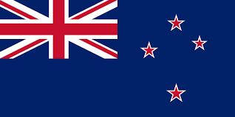
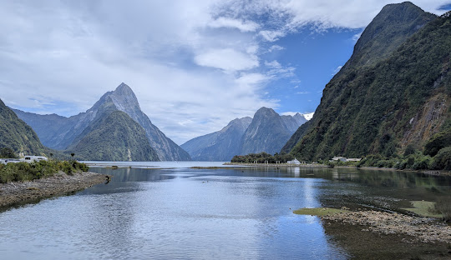
New Zealand
Geography: New Zealand is an isolated small island (approximately 268,000 square kilometers) located in southwestern Pacific Ocean.
Culture: New Zealand has the largest Polynesian population in the world. The country has a mix of Indigenous Maori heritage, British colonial roots, –`
Economy: New zealand has a developed, export driven market economy heavily focused on trade and services

Slide 3
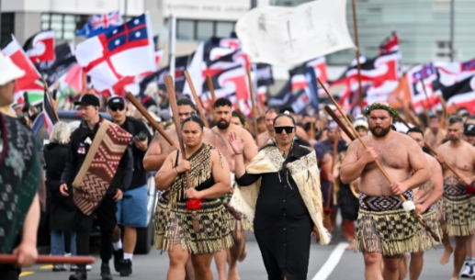
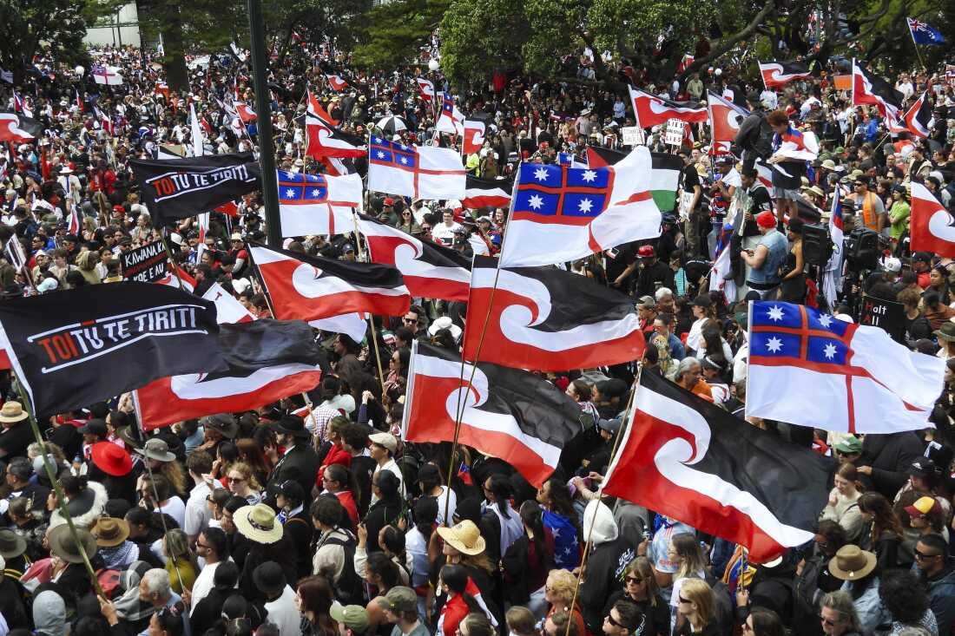
New Zealand’s Issue
The Global issue: We are going to be covering indigenous rights and reconciliation in New Zealand.
This issue is about the interpretation of of the 1840 treaty of Waitangi, shifting political mindsets and balancing the indigenous Maori rights of self determination with the conservative government policies who seek to remove race-based provisions from the law.

Slide 4
Governmentś Action
The government's action and inaction is in three hands. National Party, ACT Party and New Zealand First Party. Theses parties are on the Right wing.
Actions: In early 2024, the government legally dissolved what is known as “Te Aka Whai Ora” which is The Māori health authority, the government absorbed its duties into the general health system. They passed a legislation forcing local councils to hold required public.
Negative Actions: The government mandated that all public agencies must use english as their primary language limiting the official use of the Māori language (Te Reo Māori).
To honour an agreement with the ACT party, the government introduced a deeply divisive bill to legally redefine the principles of the Treaty of Waitangi.

Slide 5
Government´s Inactions
The government's actions is what destroyed the Treaty principles bill.
The treaty Bill is very controversial because of the way people think about it:
The Waitangi Tribe stated that the Bill is ¨the worst, most comprehensive breach of treaty… In modern times” (Source is from theguardian). The Bill is also focused on treating people the exact same, prioritizing Equality over Equity.
The government has failed to eliminate unusually deep systemic inequalities, leaving the life expectancy of Māori seven years shorter than non-Māori.

Slide 6
Consequences
The government's actions, inaction and their handling of the Waitangi Treaty backfired. The public hated the bill so the prime minister, Christopher Luxon, had to call his own coalition bill, a terrible policy to stay away from the public backlash.
In April 2025, the bill was read again and when people voted, the ACT lost 112 to 11. The ACT party were the only ones who voted for the motion.
The bill caused the Hikoi Mo Te Tiriti, the largest protest in New Zealand. Over 100,000 people marched on Parliament. This movement is still active this year.

Slide 7
Connection to Canada
The base connection to Canada is in New Zealand and in Canada, their treaties were signed with the Crown. New zealand signed its treaty of Waitangi with the british crown February 6, 1840 and the treaties in Canada were signed with the crown. The reason behind is because in Canada’s system, the crown represents the ultimate authority the exact same with New Zealand.
In 2007 when the United Nations introduced the UNDRIP (United Nations Declaration on the Rights of Indigenous nmnmnjmhPeoples) Canada and New Zealand were the two of four nations in the entire world to vote against it because they didn't want to give indigenous people too much power.
Canada later signed the UNDRIP in 2010 and the official government issued an official statement for support but the administration in 2010 declared that the UNDRIP is an aspirational document and is not legally binding.

Slide 8
Connection to Canada
Some of the positive things the New Zealand government has done for the indigenous people include:
In June 2026, the government of New Zealand gave $5.3m in new investments through the Māori Development Fund.
There are major projects like an upgrade to Akaroa King Salmon where the government of New Zealand invested 1.5m so they can create about 50 new high paying jobs within Māori communities.
The government set aside $48m over the next 4 years to help support Māori broadcasting and digital media. Their goal is to help traditional Māori media move into digital spaces to reach younger generations.
This is connected to canada because we see that Canada has done a lot to help indigenous communities here. The way the government of New Zealand and Canada connect is because of how they care for their indigenous communities.

Slide 9
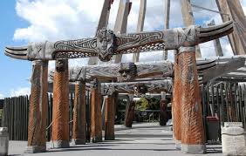

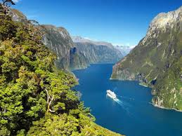
Reflection
We have seen how New Zealand and Canada relate, they are led by the same King(King Charles III).
Their parliament and legal system is the same as ours and they have even done great things for their indigenous community, just like we have so it is good that we pay attention to them and other countries that have nearly the same system as us (Australia, The United Kingdom and even Ireland.

Slide 10
References
https://www.justice.govt.nz/justice-sector-policy/key-initiatives/a-treaty-principles-bill/
https://lens.civicus.org/new-zealand-maori-rights-in-the-firing-line/
https://lens.civicus.org/new-zealand-maori-rights-in-the-firing-line/
https://www.npr.org/2023/12/08/1218317109/a-breakdown-of-the-issues-at-the-center-of-maori-protests-in-new-zealand
https://www.waitangitribunal.govt.nz/en/about/the-treaty/about-the-treaty
https://social.desa.un.org/issues/indigenous-peoples/united-nations-declaration-on-the-rights-of-indigenous-peoples
https://www.beehive.govt.nz/release/m%C4%81ori-development-fund-backing-growth-jobs-and-exports

